Slide 1
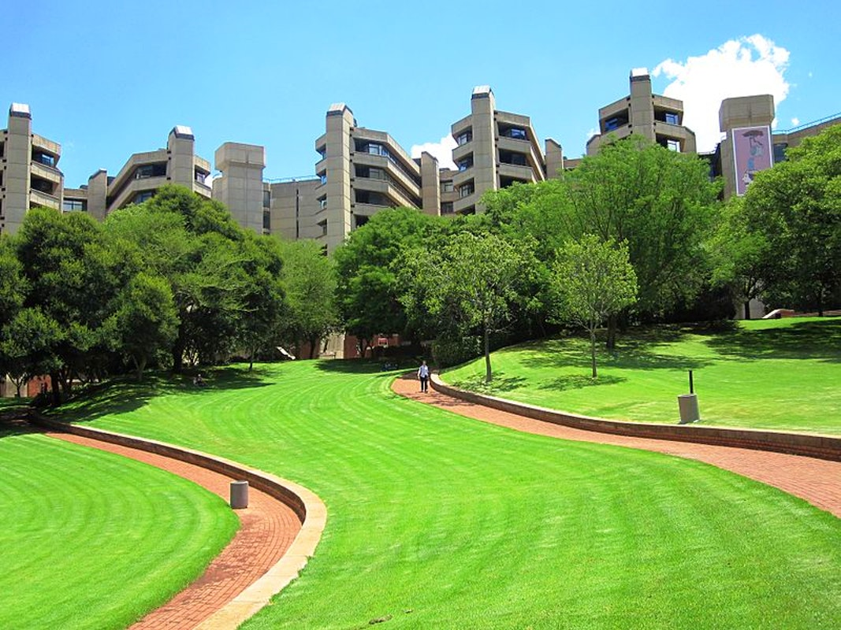
Our Academic Responsibility to Society
Presentation for AESIS
Chris Brink
2022-05-27
“Research institutions need to undergo a culture change … to stimulate societal impact of research”
AESIS

Slide 2
Two key questions for academia
What are we good at?
What are we good for?

Slide 3
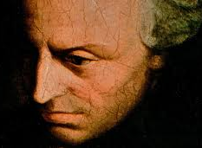
Our classic response to the ‘good for’ question
The ‘invisible hand’ argument: Free knowledge creation, if done well, will benefit society in the long run
So, a strong response to the ‘good at’ question will suffice also as a response to the ‘good for’ question
In support of this argument, we have many examples – and a well-developed conceptual framework
Immanuel Kant: Academic Freedom
John Henry Newman:
Knowledge for its own sake
Wilhelm von Humboldt: Curiosity-driven research

Slide 4
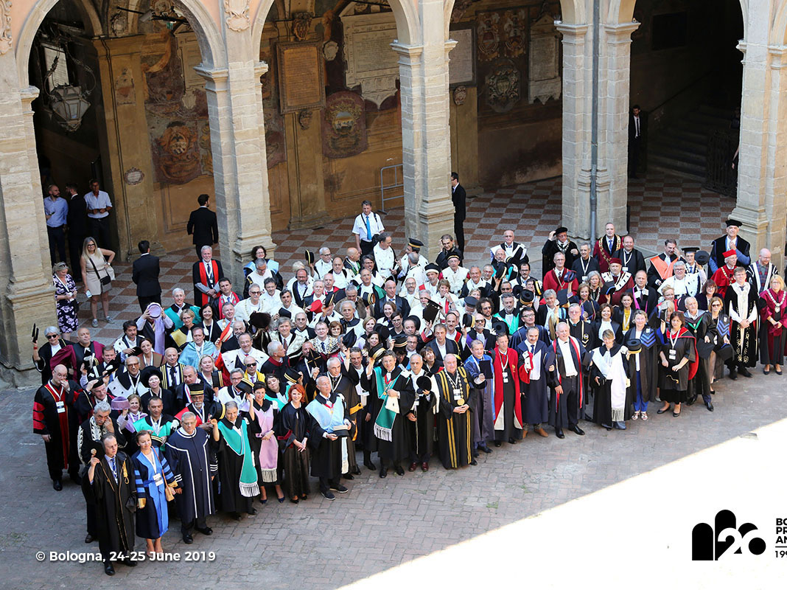
But still: A global unease about our role in society
“ Universities do not exist for themselves or for members of their academic communities in the first place. Their role and use is a societal one.
… Is HE ready to move beyond present indicators of productivity in research and teaching and integrate scientific excellence with social responsibility? …The rise of ‘populism’ with its strongly anti-elitist and anti-intellectual tendencies makes universities look as standing apart ”

Slide 5
The invisible hand argument might be true, but it cannot be the whole truth.
The benefits of the invisible hand are slow in coming and unpredictable in nature
By definition, the invisible hand is not responsive to societal challenges
From the point of view of societal need, the invisible hand argument looks like an abdication of social and moral responsibility
- Which raises the larger question of our academic responsibility to society

Slide 6
The Changing Mission of Higher Education
This change has been happening for some time …
Around the world, in various ways and under various names
I will give some examples, and then summarise them under one heading – academic responsibility

Slide 7
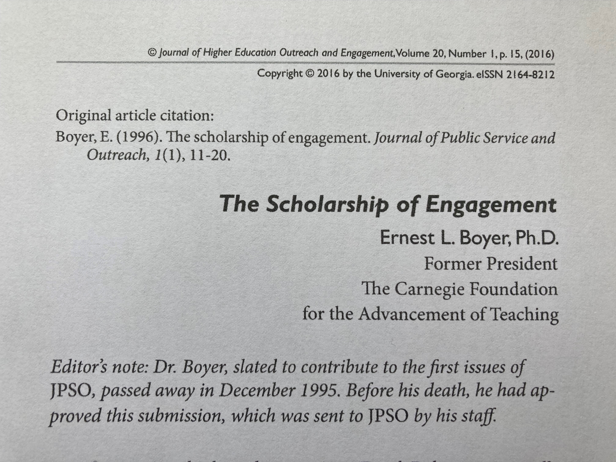
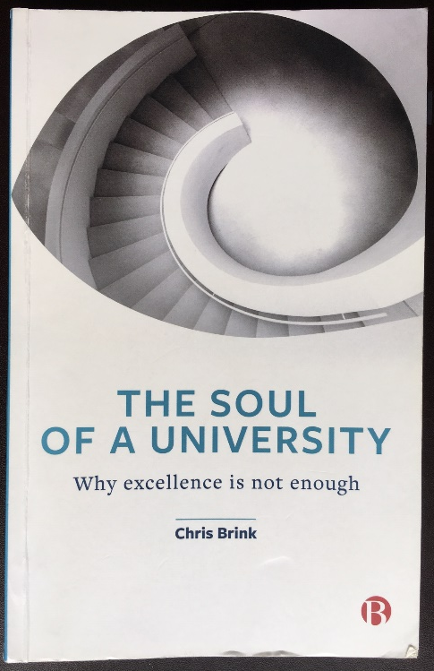
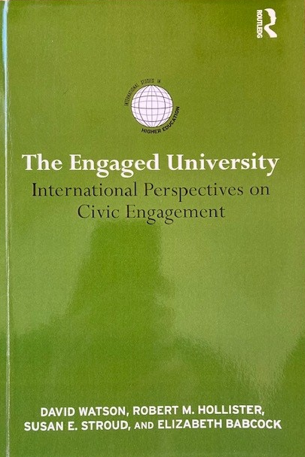
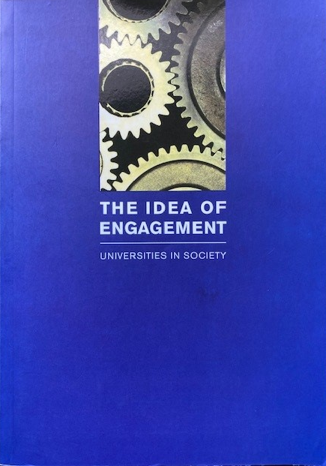
Example 1: The idea of engagement
“[Our] outstanding universities and colleges remain, in my opinion, one of the greatest hopes for intellectual and civic progress in this country. I’m convinced that for this hope to be fulfilled, the academy must become a more vigorous partner in the search for answers to our most pressing social, civic, economic and moral problems, and must reaffirm its historic commitment to what I call the scholarship of engagement.”
Ernest L Boyer, 1996

Slide 8
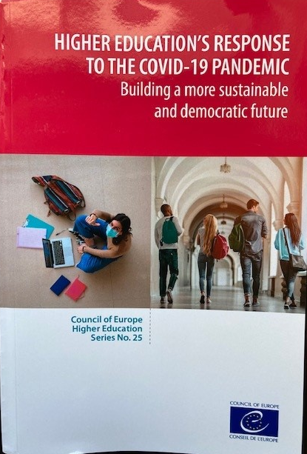
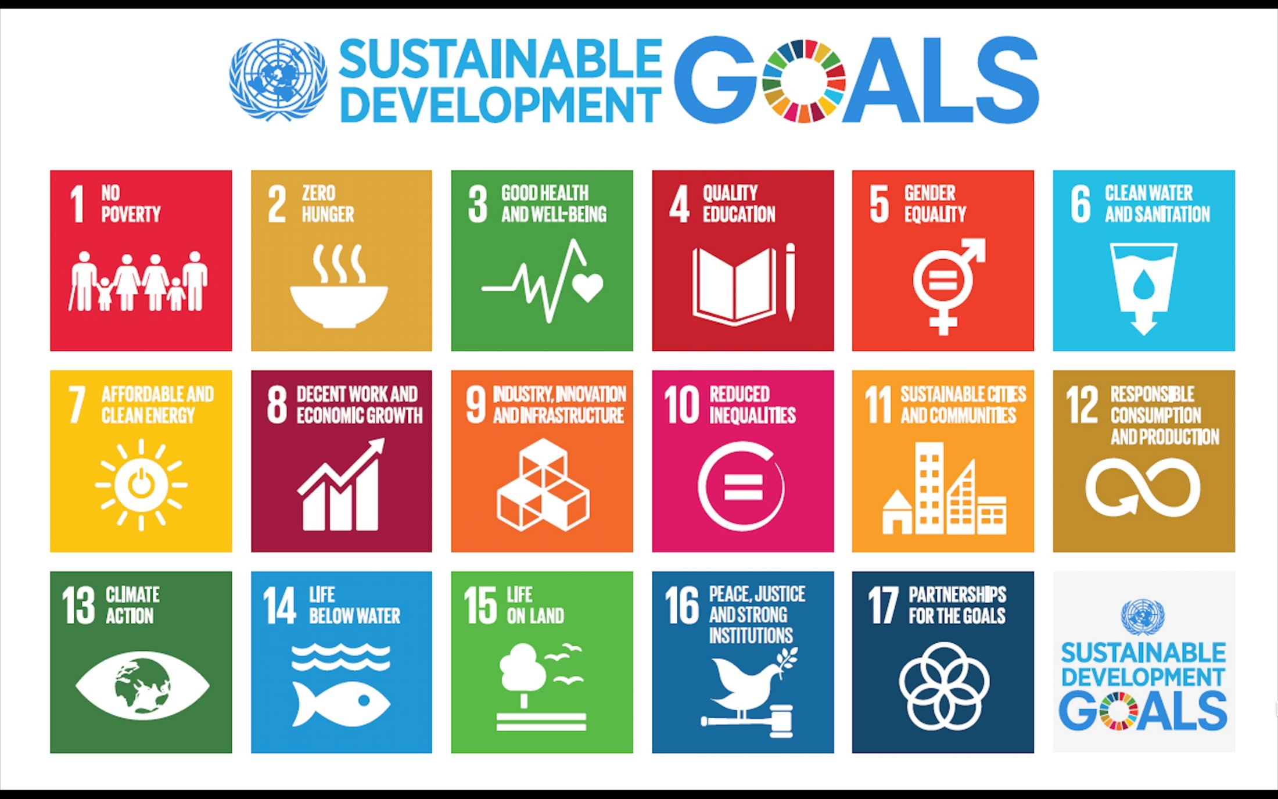
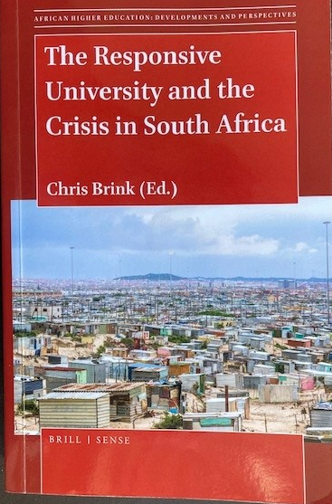
Example 2: The idea of responsiveness

Slide 9
Example 3: The idea of research impact
A new and additional category of research evaluation:
‘What beneficial impact has the research of your university made on society at large?’
‘And what evidence can you provide of such impact?’
Impact is about improving people’s lives. It could be in terms of the economy, technology, industry, innovation, health, culture, policy, services, …
Already in place in a number of countries, and happening in others
Not just ‘What are you good at?’, but also ‘What are you good for’
“ Political decision-makers worldwide commit substantial amounts of public funds to support and foster scientific research on behalf of and for the society they represent. In return, they expect publicly funded research to generate some measure of impact. ”
Global Research Council, 2019

Slide 10
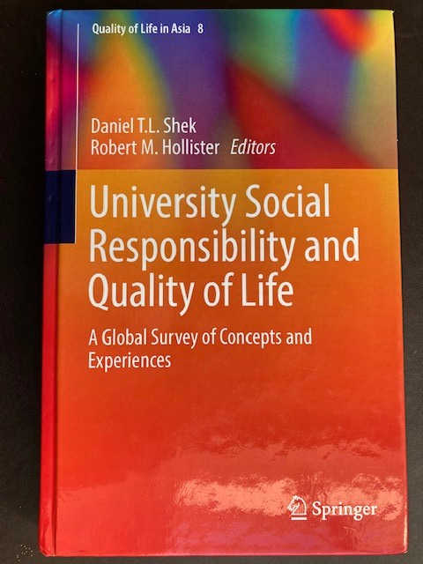
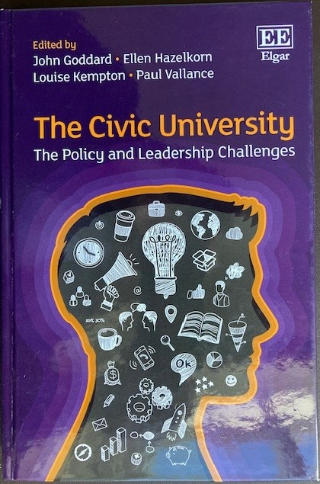
Example 4: The idea of university social responsibility
“University social responsibility (USR) extends the traditional mission of universities in an endeavour to develop solutions for economic, social and environmental problems in society.”
http://www.usrnetwork.org/about-usrn/background

Slide 11
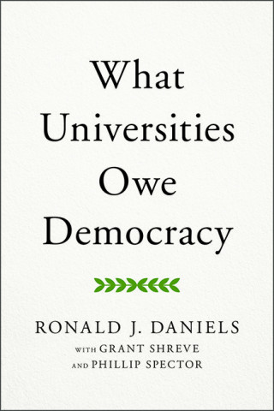
Example 5: The defence of democracy
“I believe that universities should be recognized as standing firmly among the institutions critical to securing the full promise of liberal democracy and sharing in the responsibility to protect it when its legitimacy and its durability are at risk.”
Ronald J Daniels
https://democracyjournal.org/magazine/64/what-universities-owe-democracy/
“A new kind of university is needed whose primary mission would be advancing democracy democratically on campus, in its local community, and across the wider society.”
Ira Harkavy and Rita A Hodges
https://doi.org/10.1080/00091383.2022.2030156

Slide 12
Example 6: The updated Magna Charta Universitatum
MCU 1988:
Autonomy
Independence
Academic Freedom
Updated MCU 2020:
Reaffirms the 1988 principles
But adds the principle of responsibility to society
MCU 2020:
“Universities acknowledge that they have a responsibility to engage with and respond to the aspirations and challenges of the world and to the communities they serve, to benefit humanity and contribute to sustainability.”

Slide 13
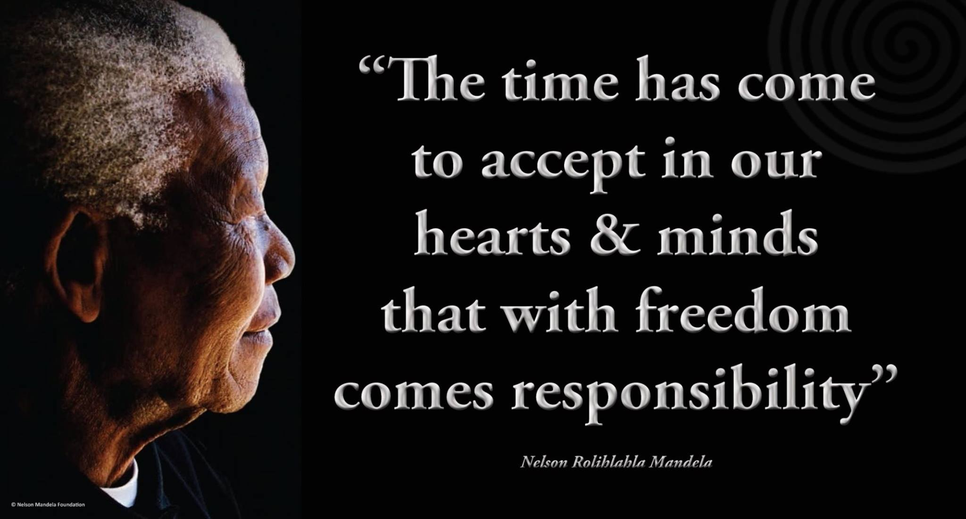
In Summary: The idea of Academic Responsibility
No freedom comes without responsibility
Why should we think that academic freedom is any different?
We spend lots of time talking about academic freedom
It is time to give equal attention to academic responsibility
Our responsibility to society

Slide 14
Caveat: Of course there are risks
External risks:
Others might be keen to tell us what our responsibilities are
Infringement of academic freedom on the grounds of an external view of responsibility
Internal risks:
Self-censorship
Blind loyalty
IN PRINCIPLE:
Each university should be free to decide for itself where its civic responsibilities lie, and how to exercise them.
- But it should not neglect doing so.

Slide 15
Thank you

